Slide 1

Project on National Data Portals in Samoa and Fiji Workshop 2 Experience Sharing and SDMX/.Stat Suite Tools 27-31 January 2025 Suva, Fiji
.Stat Suite: Data Explorer

Slide 2


Learning objectives
At the end of this session, you will be able to:
Find the various components of the .Stat Suite Data Explorer tool
Explain what each component is designed for
Search for, filter, structure the layout, and share data flows through the Data Explorer
Understand strengths and constraint of the Data Explorer

Slide 3
Outline
Search for dataflows
Filter dataflows
Caveats
Structure the layout of dataflows
Share dataflows

Slide 4
Link
https://stats.pacificdata.org/

Slide 5
Documentation
Using .Stat Data Explorer - .Stat Suite documentation

Slide 6
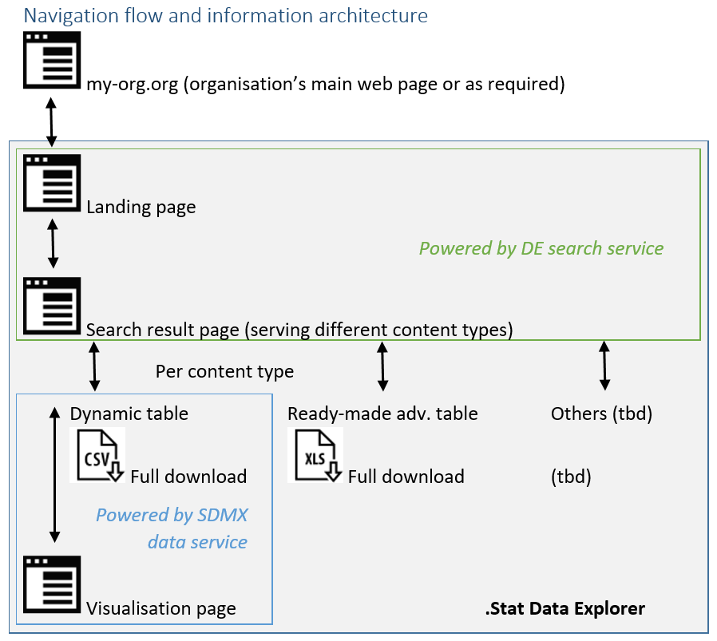
Architecture

Slide 7

Search

Slide 8
Search
“Let me easily access the organisation’s statistical data. Let me find, understand and use the data I need.”

Slide 9
Search
By keywords
By categorization

Slide 10
Search
By keywords
Where search is performed
The free text search of the Data Explorer looks for a specific language in the following pieces of information:
ID and localised name of the dataflow
IDs and localised names of the dimensions (concepts)
Localised description of the dataflow
ID and localised name of the categories (and their parent categories) in which the dataflow is categorised
IDs and localised names of the codes used as dimension values
Agency ID of the dataflow
Version number of the dataflow
The relevance score depends on where the search term was found, which can be customised

Slide 11
Search
By keywords
Exact single match word or multiword
Return all dataflows that have the exact match of all the search words.
Search hints like AND, + and - are not supported.
Exact phrase
Return all dataflows that have the exact match phrase in the indexed information.
Entered by using quotes, e.g. "exchange rate".
Partial match of a word
Apply the same rules as for exact match but for partial matching: based on stems or synonyms, e.g. keys is found through key.
Note: It is not used for exact phrases.

Slide 12
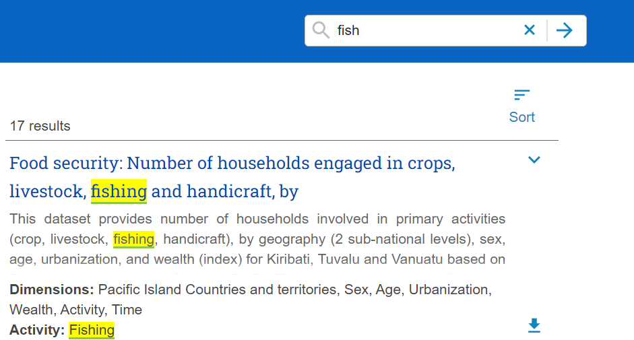
Search
It understand synonyms: fish -> fish, fishes, fishing, fishery, …

Slide 13
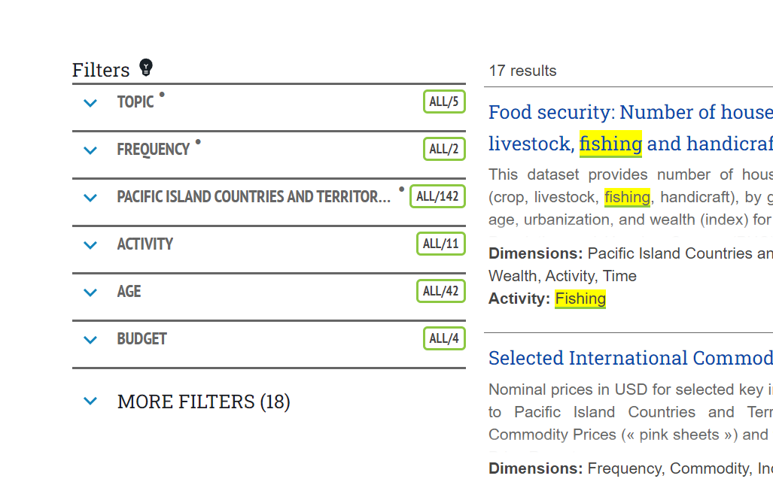
Search
Results can be filtered by combined dimensions

Slide 14
Search
Only those facets are included, for which the dataflows listed as search results have values.
Facets

Slide 15
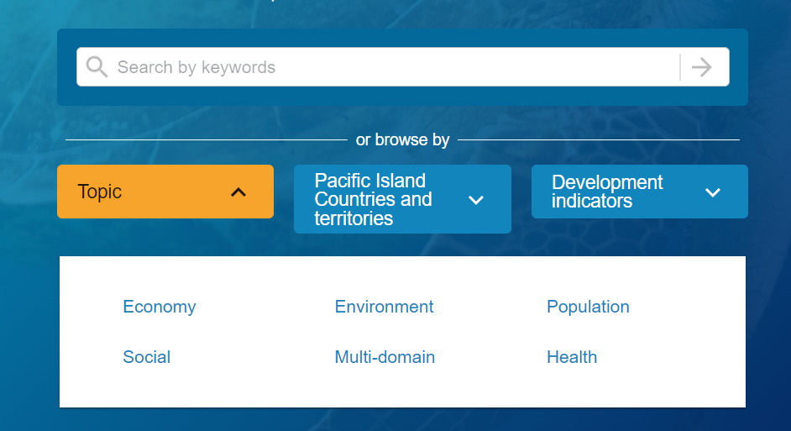
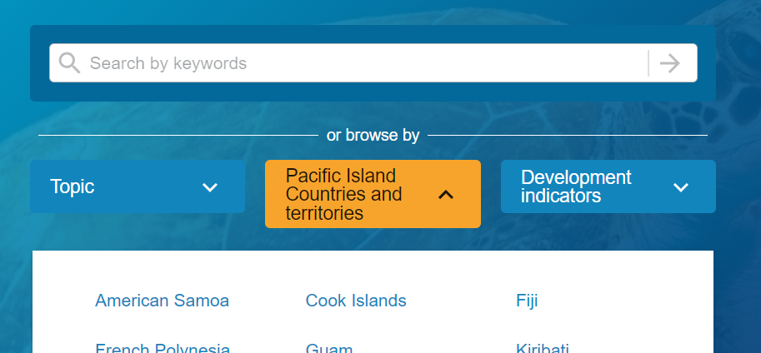
Search
Facets
One facet per localised Category Scheme

Slide 16
Search
Facets displayed with a dot [.] after their localised name are called pinned facets. Those facets are displayed, when available, always at the first top position(s) in the facet list.
Facets

Slide 17
Search
One facet per concept that is used to define dataflow dimensions
Facets
all concepts having the same localised name (not ID) are grouped into one facet

Slide 18
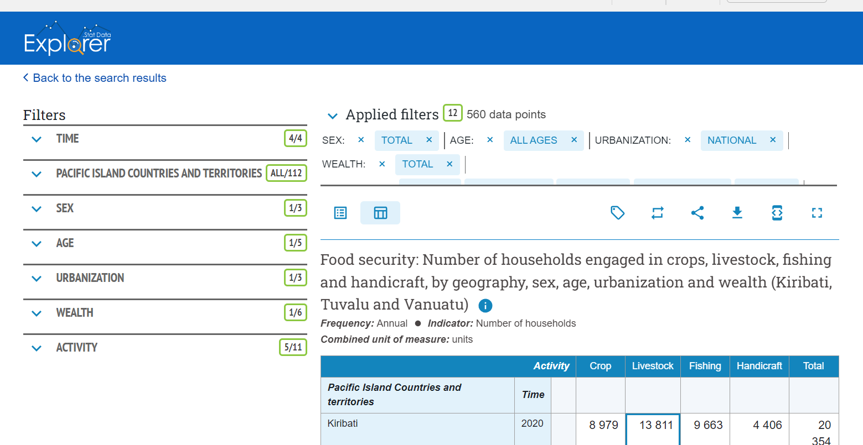


Filter
The current filters selection
a set of dimension filters that allow dynamically filtering the dimension values

Slide 19
Filter
A filter is created for each of the dimensions of the currently displayed dataflow based on data availability, except if the dimension contains only one possible item or if it is configured to be hidden.

Slide 20
Filter
The order of the filters is defined in the Data Structure Definition
The filter title contains the localised name of the dimension’s concept
Number of currently selected filter items

Slide 21
Filter
All* filter other filters are standardised multi-selection.
* Frequency and Time Period are different

Slide 22
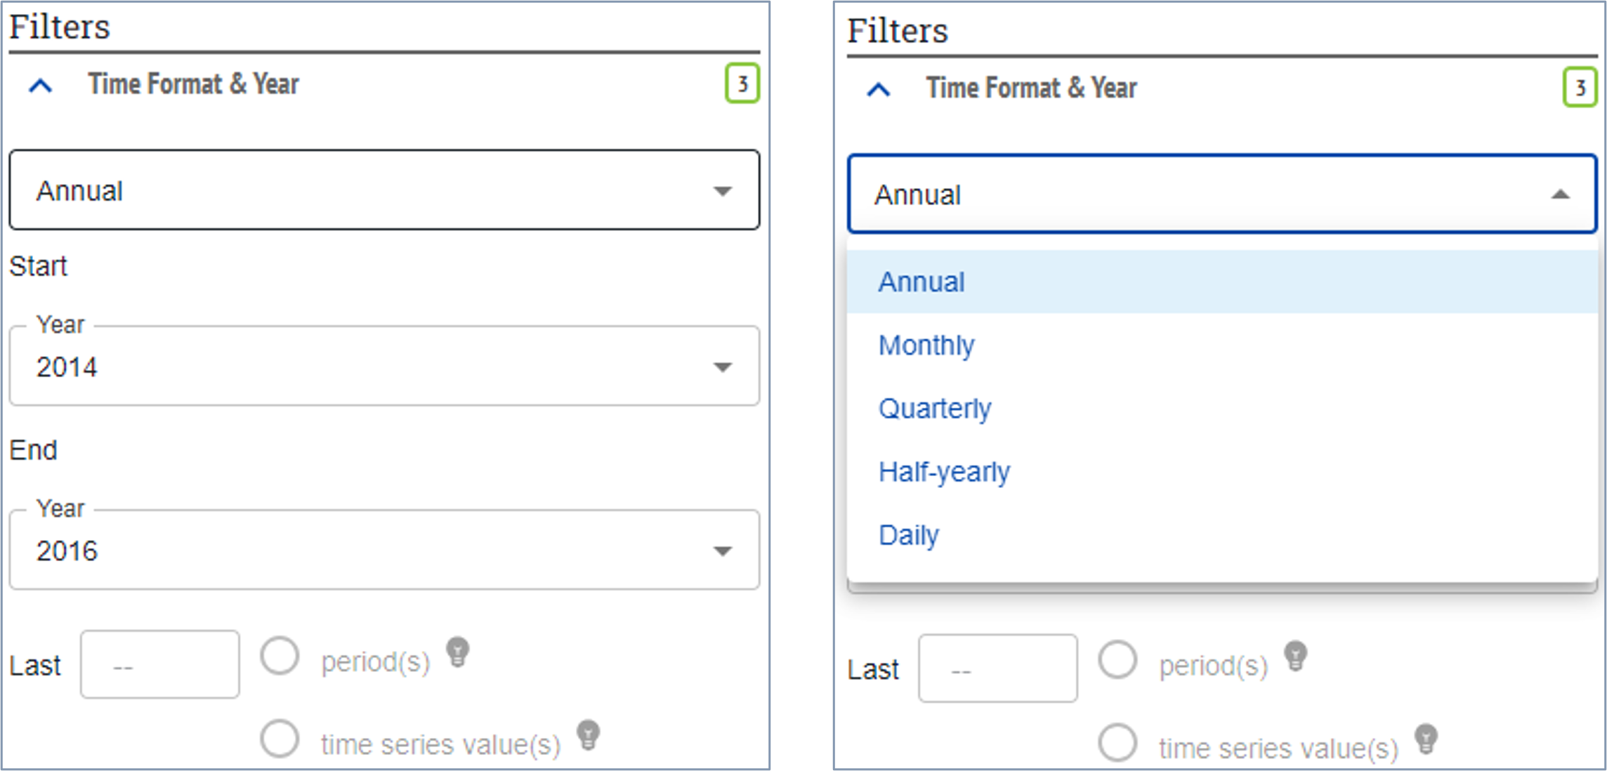
Filter
Frequency is single selection
Time period is dynamic and updates according to the Frequency.
(Frequency & Time-Period - .Stat Suite documentation)

Slide 23
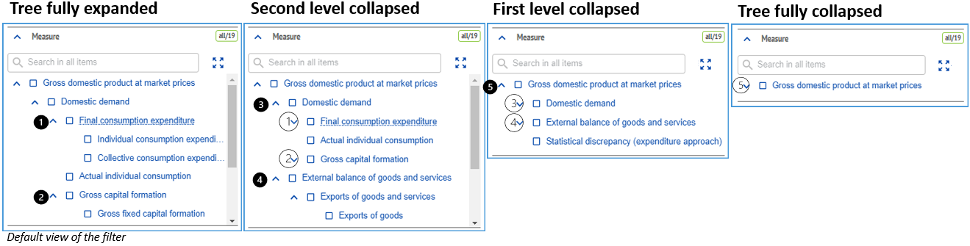
Filter
Hierarchical codelists are shown as ‘a tree’

Slide 24
Filter
To reduce the risk for users to end up with an empty data table, the filter values are limited to those items for which data exists.

Slide 25
Filter
The ‘Applied filters’ panel displays all currently selected items per dimension of the data table.

Slide 26
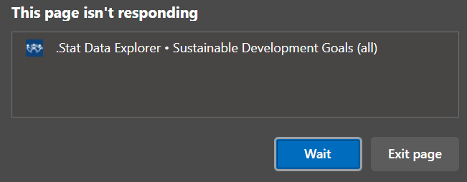
Caveats
Large data might freeze browsers. Apply filters accordingly.

Slide 27
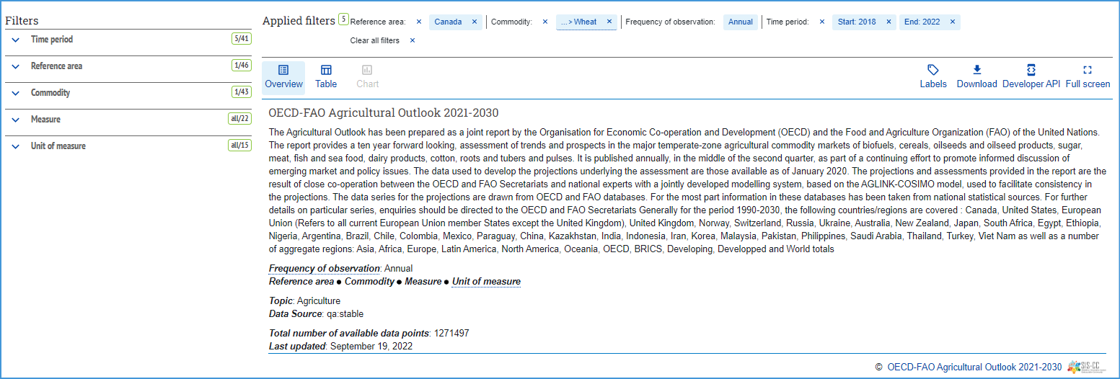
Layout
summary of complementary information for the data provided in table and chart views
same DSD -> related dataflows (can be changed)

Slide 28
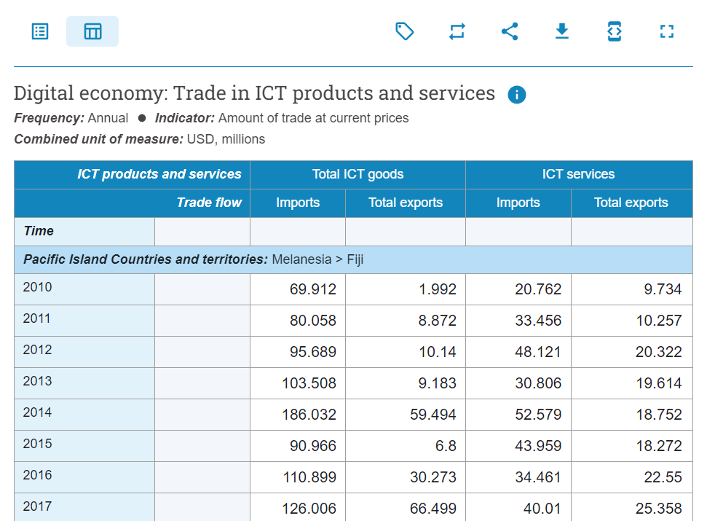
Layout
Preview table
The preview-tables are not meant to be publication-ready statistical tables. They are only meant to provide a quick mean for users to validate that they have found the data that they were looking for.

Slide 29
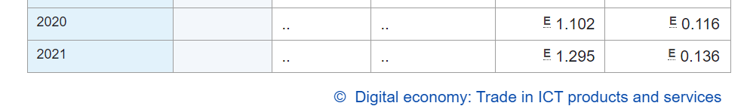
Layout
Preview table
header
row section
table grid
row
footer
column

Slide 30
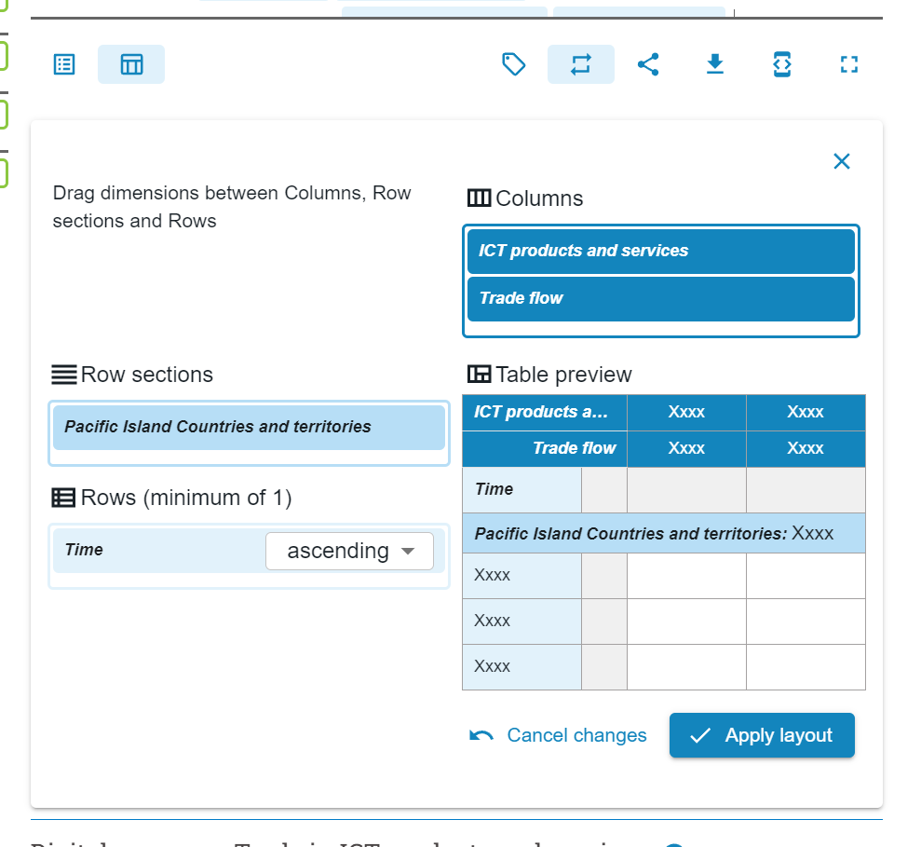
Layout
Layout is defined in SDMX artefacts Can be modified by the user
Best way of learning: play with it!

Slide 31
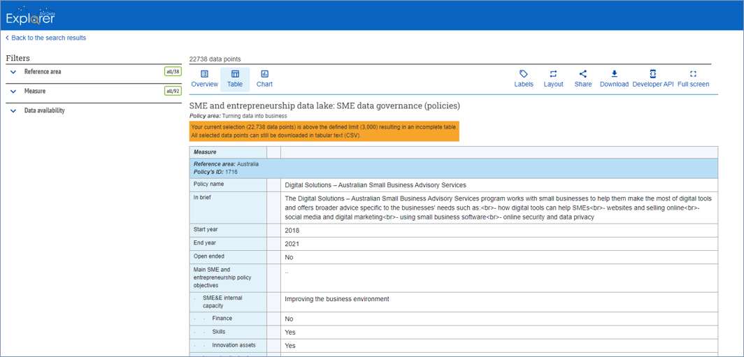
Layout
Observations values in textual formats can be displayed in the table!

Slide 32
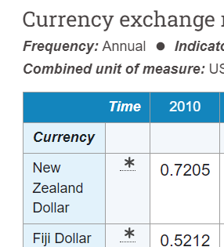
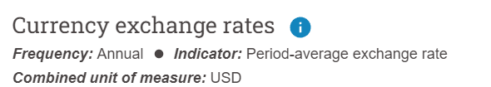
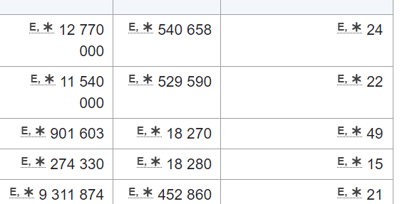
Layout
Attributes and referential metadata

Slide 33
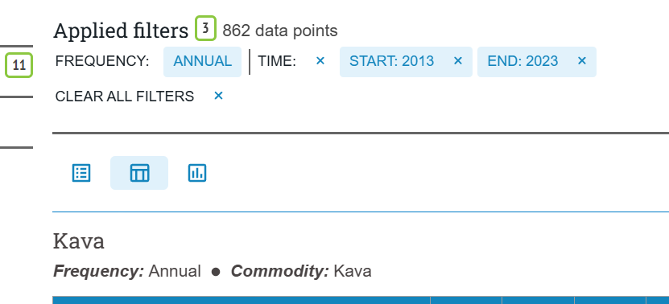



Visualize
DE allow to create some basic data viz

Slide 34
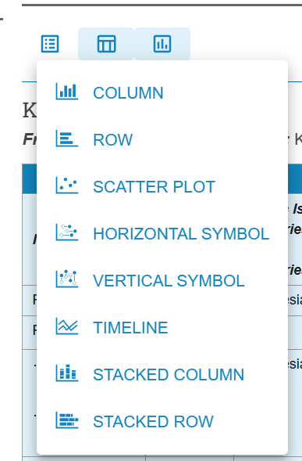
Visualize
You can pick one of these styles

Slide 35
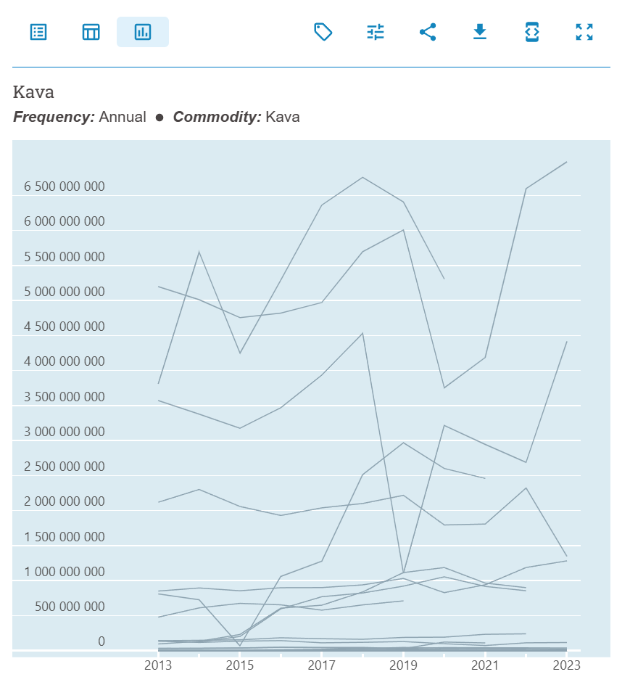

Visualize
If you don’t filter carefully the data, you get rubbish viz!

Slide 36
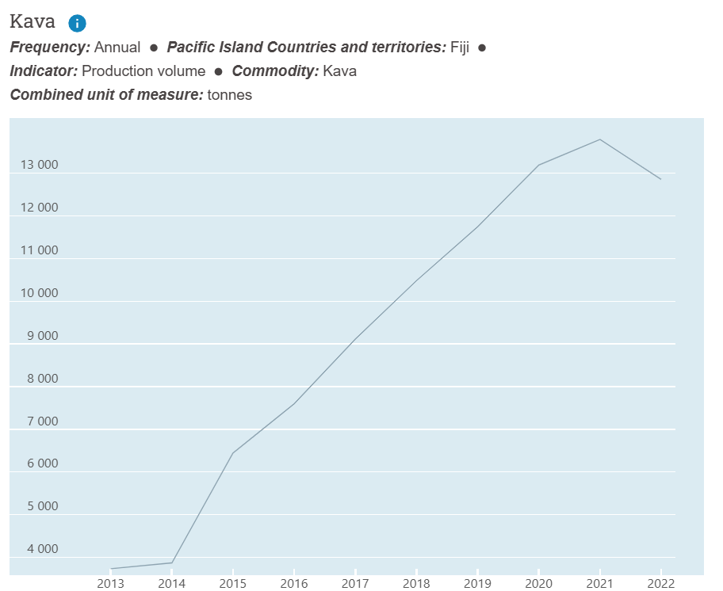
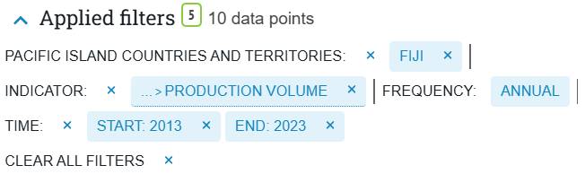
Visualize
If you don’t filter carefully the data, you get rubbish viz!

Slide 37
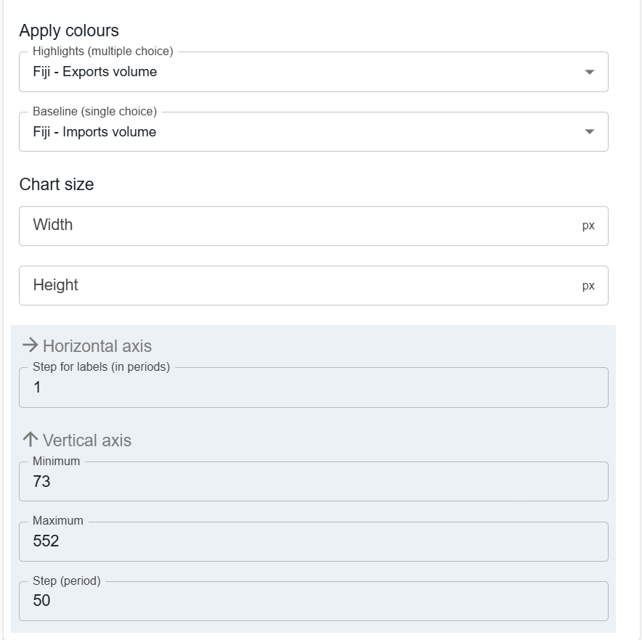
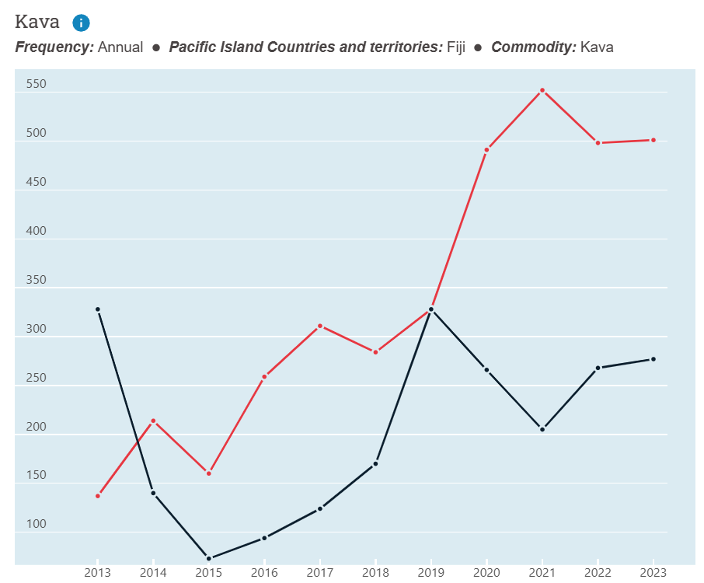
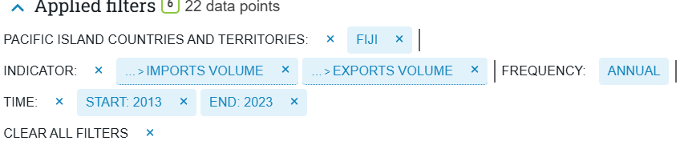
Visualize
And customise ☺

Slide 38
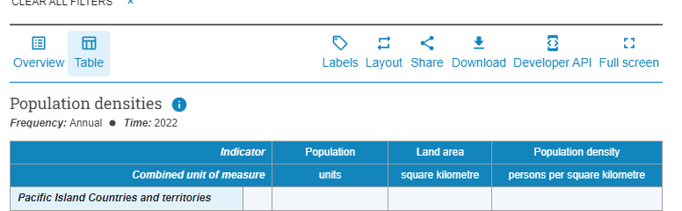


Share

Slide 39
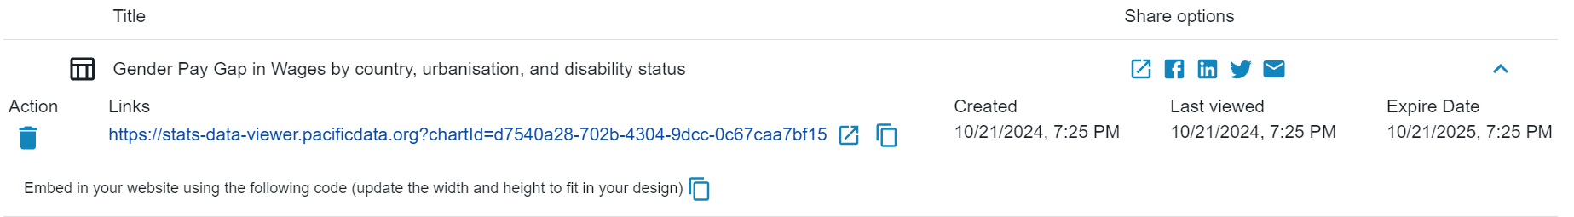
Share
Share for non-coders
links to DE

Slide 40
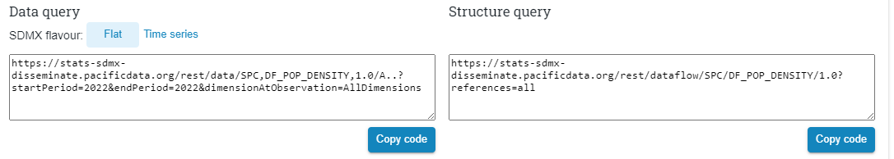
Share
Share for coders
links to SDMX API

Slide 41
Share
Share for non-coders
links to DE
Share for coders
links to SDMX API

Slide 42
Exercise
Navigate to data-test.sbs.gov.ws, look for an interesting indicator in the Kava dataflow:
Realise a graphical visualization
Work as a group:
Pick a visualization created by one of you: How can you improve it?

Slide 43
Discussion and Q&A

